Slide 1
An Improved Parallel Simulated Annealing Algorithm Used for Protein Structure Prediction
Yun-Ling Liu and Lan Tao,
Proceedings of the Fifth International Conference on Machine Learning and Cybernetics, Dalian, 13-16 August 2006.
Presenter : Hsiao-Yen Chang
Date : April 17, 2008

Slide 2
Abstract
This paper introduces an improved Simulated
Annealing --Parallel Simulated Annealing with Genetic
Crossover: PSAGC, and uses this method in energy
minimization problem of protein structure prediction.
Through experiments on three real proteins, PSAGC is
proved more effective than SA and PSA, it can
achieve conformations which have lower energy
values. Then the paper investigates crossover interval
and crossover method of PSAGC, and obtains useful
conclusions.

Slide 3
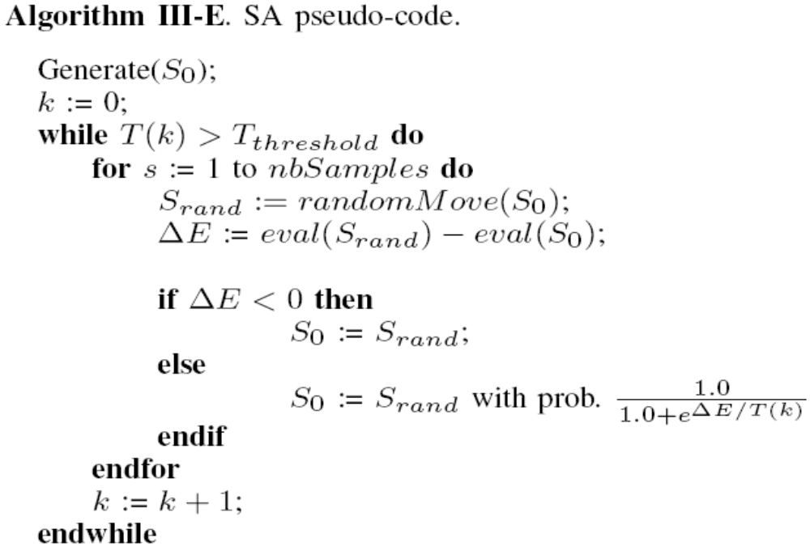
Simulated Annealing Algorithm

Slide 4
ECEPP/2
Empirical Conformational Energy Program for Peptides and Proteins (ECEPP)
[Moma75]、[Neme83]、[Sipp84]

Slide 5
PSAGC
In this algorithm, the total number of SAs running in parallel is defined as population size and the solution of each SA is corresponded to one individual of GA.

Slide 6
PSAGC
SA1
SA2
pairs
SA3
SA4
SA1
SA5
SA2
SA3
SA4
SA6
SA5
SA6
crossover
sa1
sa2
sa3
sa4
sa5
sa6
SA1
SA5
SA2
sa4
sa5
sa6

Slide 7
PSAGC
The following steps are the flow of PSAGC:
  Step 1: Assume an initial temperature. Initial individuals are generated randomly.
  Step 2: Each individual is given to one SA as an initial searching point. SA is executed in parallel in the order of generating a new solution. Then accept the solution, and cooling a temperature.
  Step 3: When annealing has been done for the specified steps. The pairs are generated randomly from those solutions. The number of pairs is a half number of the individuals.

Slide 8
PSAGC
  Step 4: The crossover is applied to a pair and two children are generated.
  Step 5: The best two individuals which have higher fitness values, lower energy values are selected from the four individuals (two parents and two children). These two individuals are new initial searching points for the next SA.
  Step 6: The operations from Step 4 to Step 5 are applied to all the pairs.
  Step 7: The steps between two to six are iterated until the terminal criterion is satisfied.

Slide 9
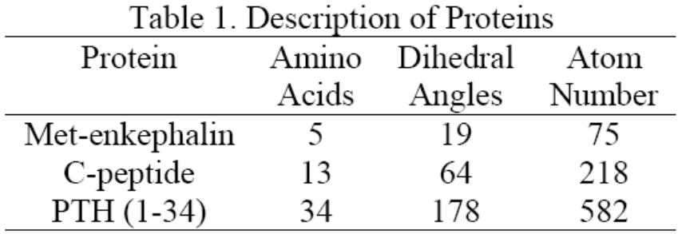
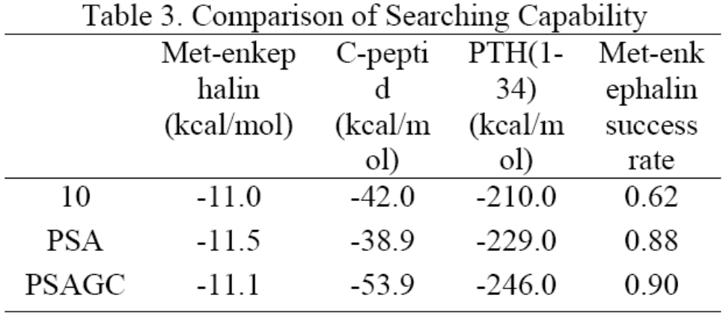
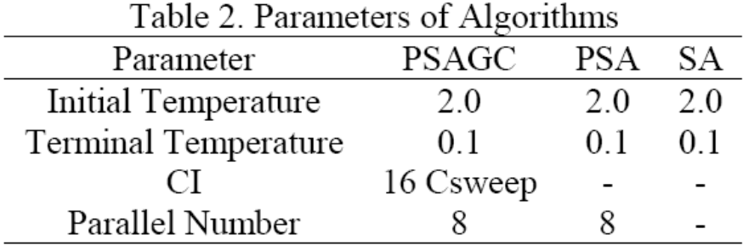
Results
SA
Crossover Interval (CI)
Monte Carlo Sweep (MCsweep)

Slide 10
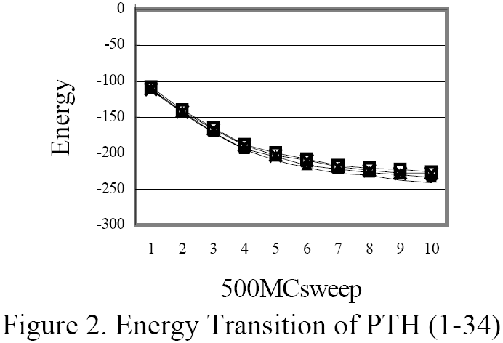
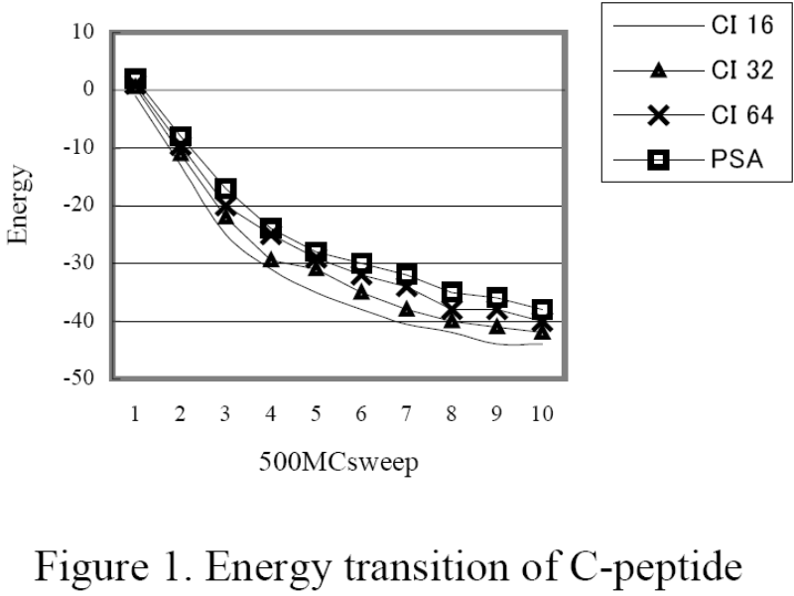
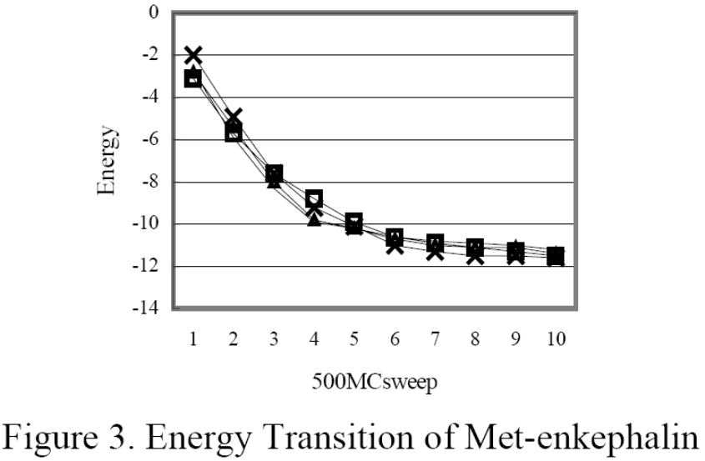
Results
Crossover Interval of PSAGC

Slide 11
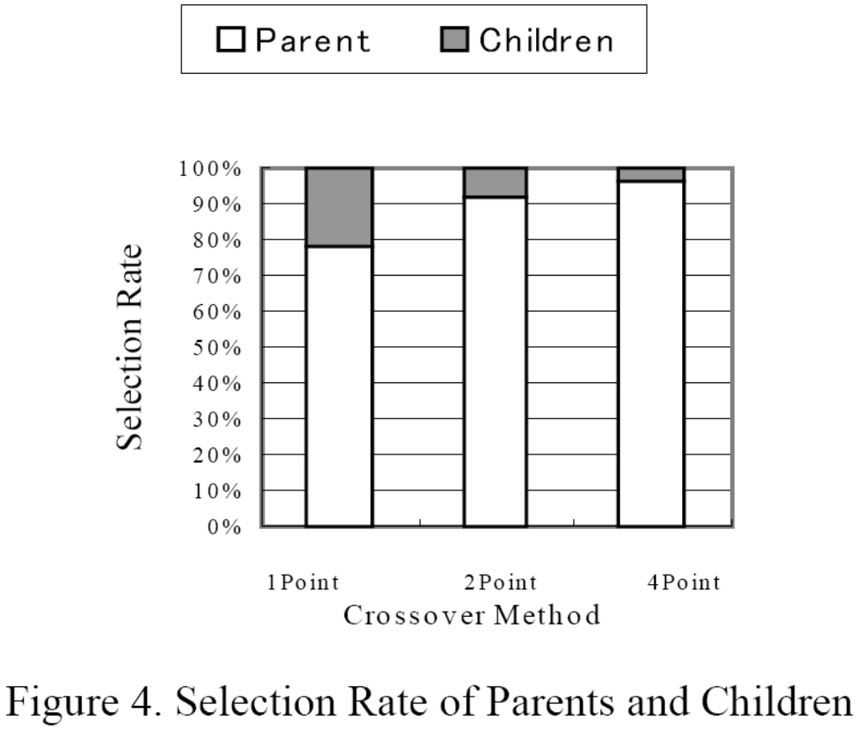
Results

